Slide 1
Performance appraisal and Career Strategy
Session 16

Slide 2
Performance appraisal
A performance appraisal is a regular review of an employee's job performance and overall contribution to a company. Also known as an "annual review," "performance review or evaluation," or "employee appraisal," a performance appraisal evaluates an employee’s skills, achievements and growth, or lack thereof.
Companies use performance appraisals to give employees big-picture feedback on their work and to justify pay increases and bonuses, as well as termination decisions. They can be conducted at any given time but tend to be annual, semi-annual or quarterly

Slide 3
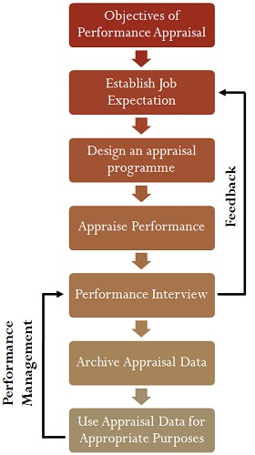
Performance appraisal process

Slide 4
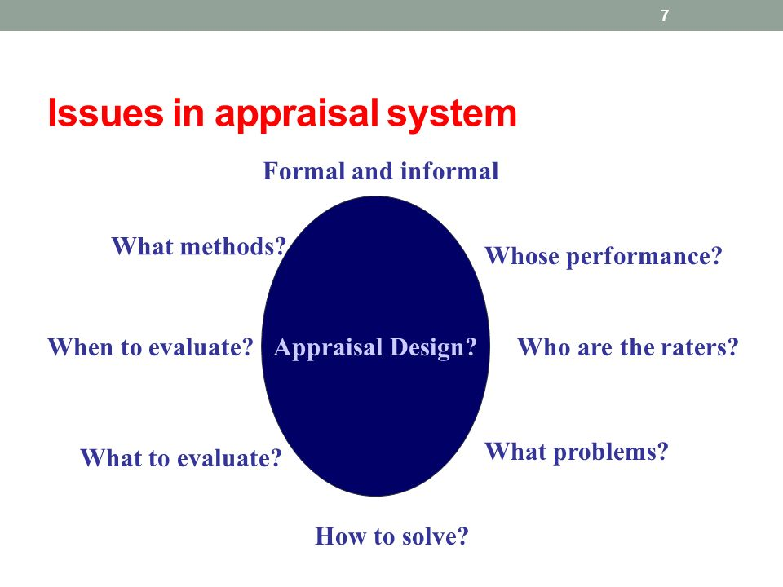
Design appraisal program

Slide 5
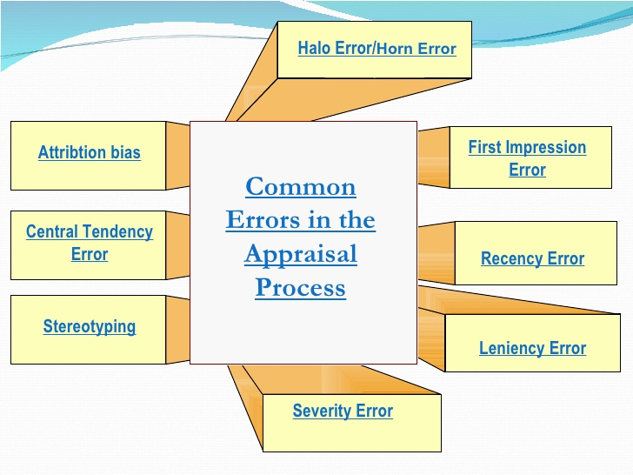
Errors in performance appraisal

Slide 6
What to evaluate
Quality
Quantity
Cost effectiveness
Timeliness
Need for supervision
Interpersonal impact
Community service(Mind tree consulting: 60 points for job performance and 40 points for CLASS(Caring, learning, achieving, sharing and social conscience)

Slide 7
Performance appraisal methods
Past oriented methods:
Rating scales
Checklist
Forced choice method
Forced distribution method
Critical incidents method
BARS( Behaviourally anchored rating scales)
Field review method
Essay methods
Ranking method
Paired comparison method

Slide 8
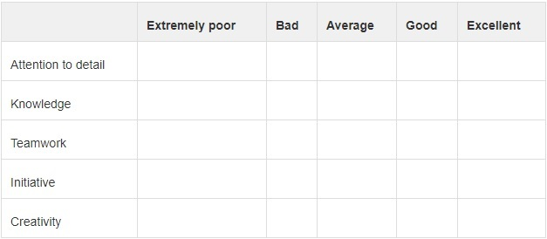
Rating scale:

Slide 9
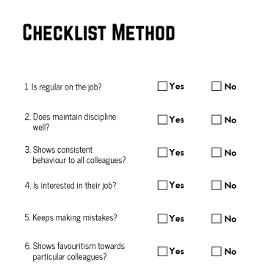
Checklist:

Slide 10
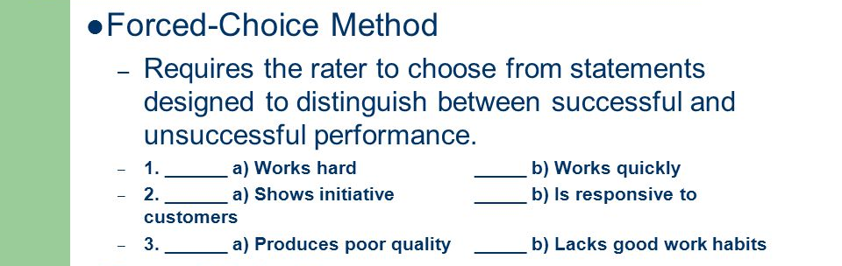
Forced-choice method

Slide 11
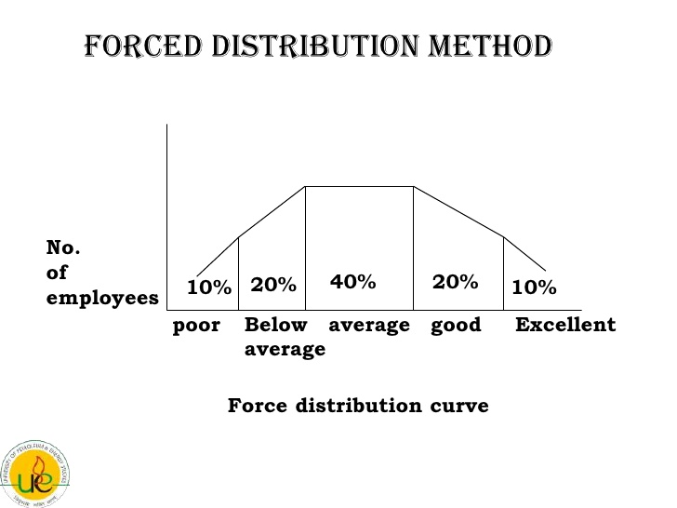
Forced-distribution method

Slide 12
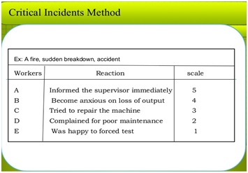
Critical incident method

Slide 13
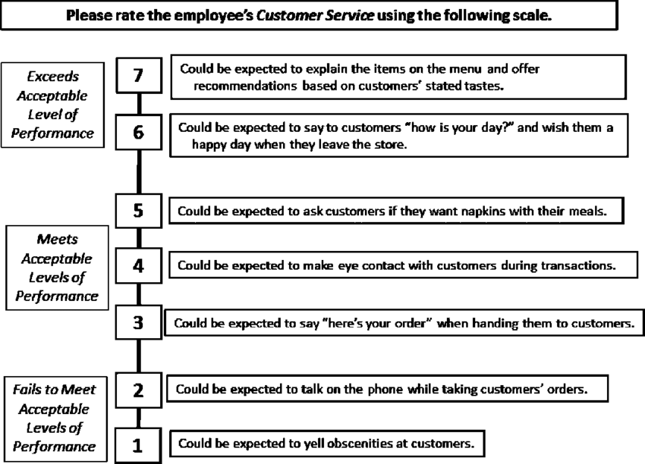
Behaviourally Anchored rating scales(BARS)

Slide 14
Paired comparision method
The number of comparisions may be calculated with the help of formula:
N(N-1)
2
Where N stands for the number of employees to be compared. If there are 10 employees, the number of comparisions will be 45

Slide 15
Future oriented methods:
MBO
Psychological appraisals
Assessment centres
360 degree feedback

Slide 16
Career Strategy
The appraisal of performance should identify the strengths and weaknesses of an individual; this identification can be the starting point for a career plan. The personal strategy should be designed to utilize strengths and overcome weaknesses in order to take advantage of career opportunities.
A career strategy is any behavior, activity, or experience designed to help a person meet career goals. A career strategy represents a conscious choice by an individual as to the type of investment he or she is willing to make in attempting to reach career objectives.

Slide 17
The steps in formulating a career strategy are as follows:
(i) Preparation of a personal profile.
(ii) Development of long-range personal and professional goals.
(iii) Analysis of the environment.
(iv) Analysis of Personal Strengths and Weaknesses.
(v) Development of Strategic Career Alternatives.
(vi) Consistency Testing and Strategic Choices.
(vii) Development of short-range career objectives and action plans.
(viii) Development of contingency plans.
(ix) Implementation of the Career Plan.
(x) Monitoring Progress.

